Slide 1
Title
Text

Slide 2
Exercise 8: Numerical Integration
MAD
bacdavid@student.ethz.ch

Slide 3
Outline
Information
Goals
Theory/ Recap
Exercises

Slide 4
Information

Slide 5
General
Lecture material & problem sets available here
Tutorial material available here

Slide 6
Goals

Slide 7
Goals of Today
Understand why we use numerical integration
Understand the basic approach for numerical integration
Know how to integrate numerically with Rectangle, Trapezoidal, & Simpson’s rule
Understand derivation of Newton-Cotes formula & how to use it

Slide 8
Theory / Recap

Slide 9

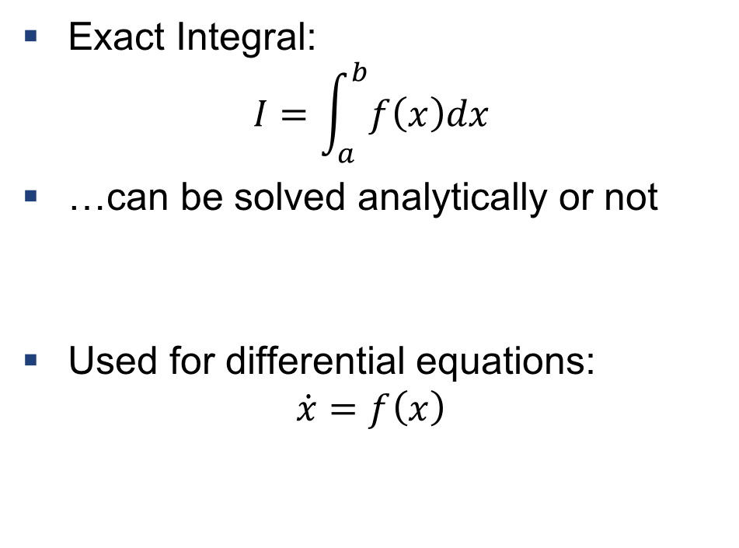
Integral
Exact Integral:
$$I=\int_{a}^{b}{f\left(x\right)dx}$$
…can be solved analytically or not
Used for differential equations:
$$\dot{x}=f\left(x\right)$$
$$I$$
https://de.wikipedia.org/wiki/Integralrechnung#/media/File:Integral_as_region_under_curve.svg

Slide 10

Example 1: ODE
Solve the ODE:
$$\dot{x}={t⋅e}^{t}, x\left(t_{0}\right)=x_{0}$$
Tipp:
$$\int_{a}^{b}{uv^{′}dx}={\left[uv\right]}_{a}^{b}−\int_{a}^{b}{u^{′}vdx}$$

Slide 11
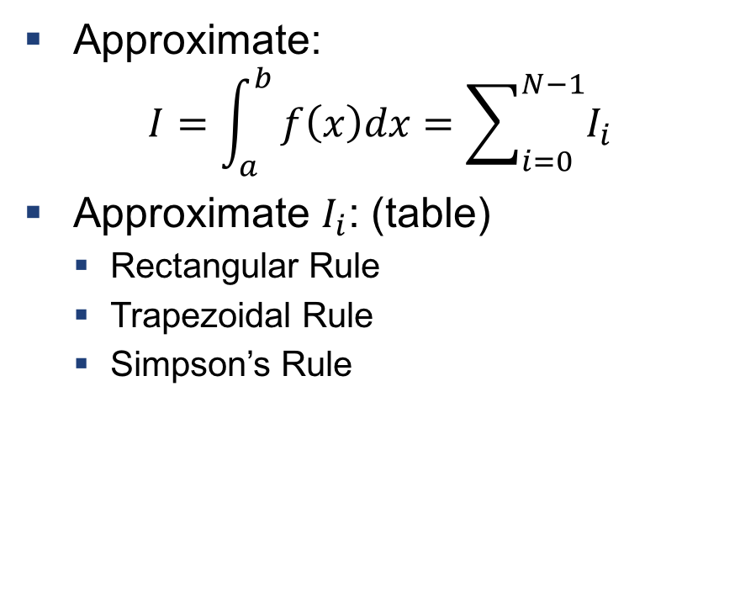
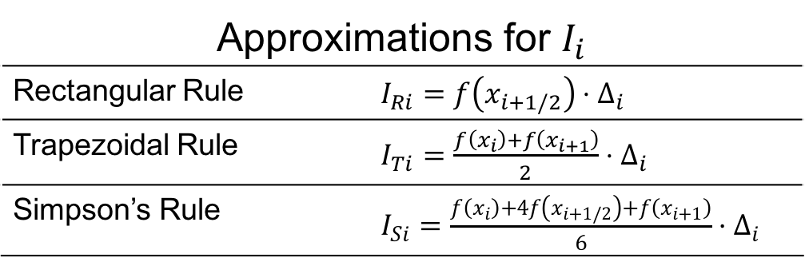
Numerical Integration
Approximate:
$$I=\int_{a}^{b}{f\left(x\right)dx=\sum_{i=0}^{N−1}{I_{i}}}$$
Approximate $I_{i}$: (table)
Rectangular Rule
Trapezoidal Rule
Simpson’s Rule
Approximations for $I_{i}$
Rectangular Rule | $I_{Ri}=f\left(x_{i+1/2}\right)⋅Δ_{i}$
Trapezoidal Rule | $I_{Ti}=\frac{f\left(x_{i}\right)+f\left(x_{i+1}\right)}{2}⋅Δ_{i}$
Simpson’s Rule | $I_{Si}=\frac{f\left(x_{i}\right)+4f\left(x_{i+1/2}\right)+f\left(x_{i+1}\right)}{6}⋅Δ_{i}$

Slide 12
Rectangular Rule
http://tutorial.math.lamar.edu/Classes/CalcI/AreaProblem.aspx

Slide 13
Trapezoidal Rule
http://tutorial.math.lamar.edu/Classes/CalcI/AreaProblem.aspx

Slide 14
Simpson’s Rule
parabola
https://de.wikipedia.org/wiki/Datei:Simpsons_method_illustration.svg

Slide 15


Example 2: Numerical Integration
Solve the integral
$$\int_{−1}^{1}{x^{2}dx}$$
Exact
Rectangle Rule
Trapezoidal Rule
Simpson’s Rule
Approximations for $I_{i}$
Rectangular Rule | $I_{Ri}=f\left(x_{i+1/2}\right)⋅Δ_{i}$
Trapezoidal Rule | $I_{Ti}=\frac{f\left(x_{i}\right)+f\left(x_{i+1}\right)}{2}⋅Δ_{i}$
Simpson’s Rule | $I_{Si}=\frac{f\left(x_{i}\right)+4f\left(x_{i+1/2}\right)+f\left(x_{i+1}\right)}{6}⋅Δ_{i}$

Slide 16
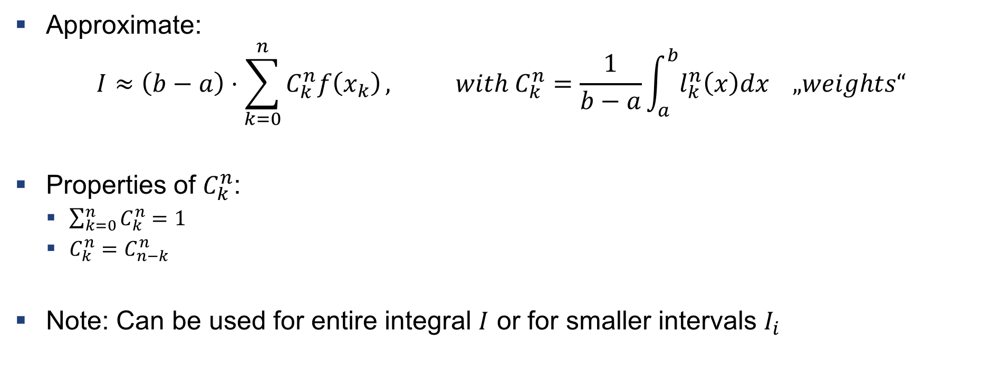
Newton-Cotes Formula
Approximate:
$$I≈\left(b−a\right)⋅\sum_{k=0}^{n}{C_{k}^{n}f\left(x_{k}\right)}, with C_{k}^{n}=\frac{1}{b−a}\int_{a}^{b}{l_{k}^{n}\left(x\right)dx „weights“}$$
Properties of $C_{k}^{n}$:
$\sum_{k=0}^{n}{C_{k}^{n}}=1$
$C_{k}^{n}=C_{n−k}^{n}$
Note: Can be used for entire integral $I$ or for smaller intervals $I_{i}$

Slide 17
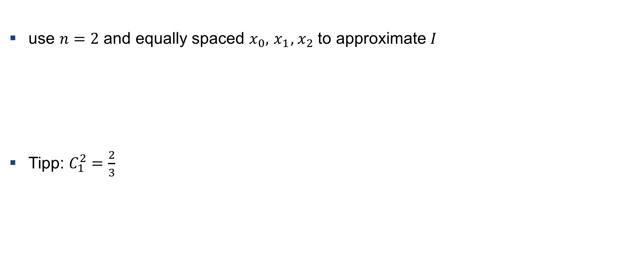

Example 3: Derive an numerical integration rule
use $n=2$ and equally spaced $x_{0},{ x}_{1},{ x}_{2}$ to approximate $I$
Tipp: $C_{1}^{2}=\frac{2}{3}$
$$I≈\left(b−a\right)⋅\sum_{k=0}^{n}{C_{k}^{n}f\left(x_{k}\right)}, with C_{k}^{n}=\frac{1}{b−a}\int_{a}^{b}{l_{k}^{n}\left(x\right)dx „weights“}$$

Slide 18
Exercises

Slide 19
Exercise 1
Recompute Simpson‘s Rule (without short-cuts)

Slide 20
Exercise 2
Use numerical integration on a practical example
Values are discretized (function unknown)

Slide 21
Exercise 3
Extension of ex 2, but analytical function is given (exact integral can be computed)

Slide 22

Questions?

